Slide 1
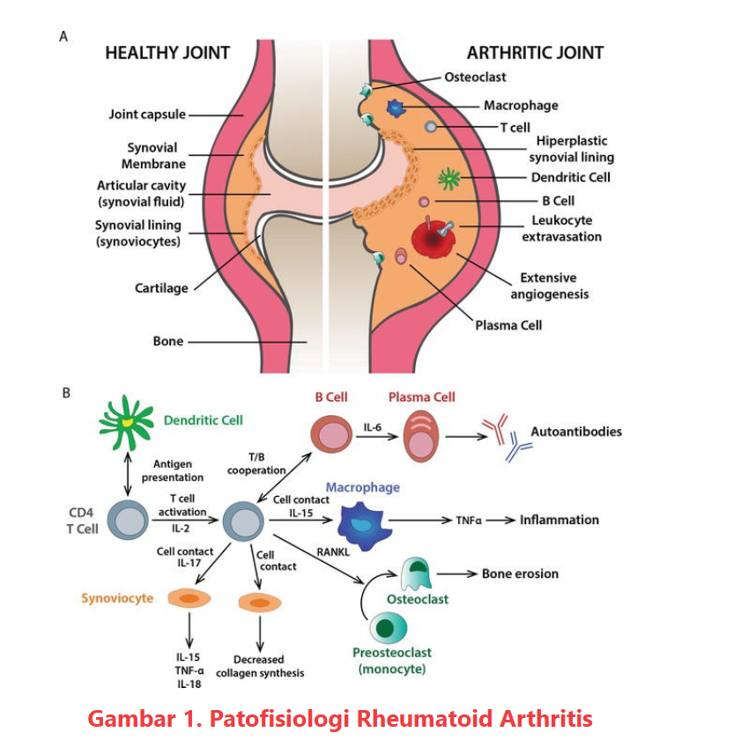
Patofisiologi Rheumatoid Arthritis

Slide 2
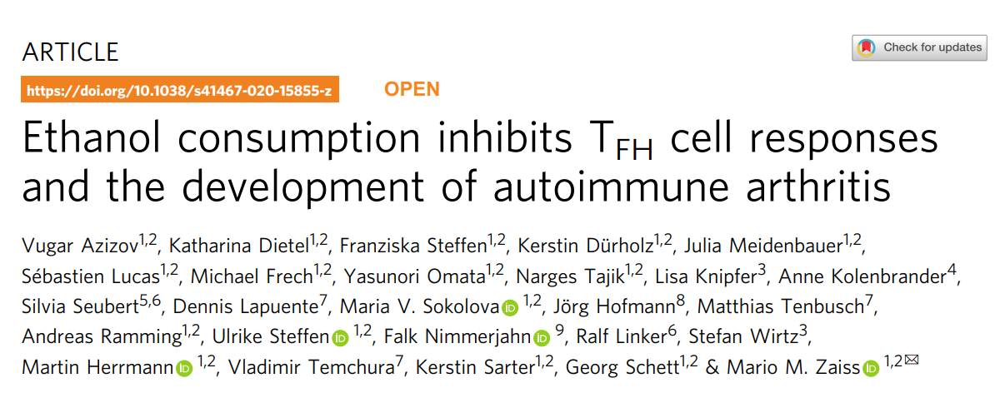

Slide 3



Author’s Information
Mario M. Zaiss

Slide 4
Experiments Logic
1.Alcohol inhibits arthritis onset
RA Model : CIA (collagen-induced arthritis);
Control and Comparison Groups : CIA vs CIA+EtOH
Time/dpi
Consumption EtOH : drinking water H2O turns to 10% EtOH
tests:
(1). lncidence lower 40%
(2). Severity lower >50%
(3). Inflammation less
(4). Bone erosion lower
(5). Osteoclast number lower

Slide 5
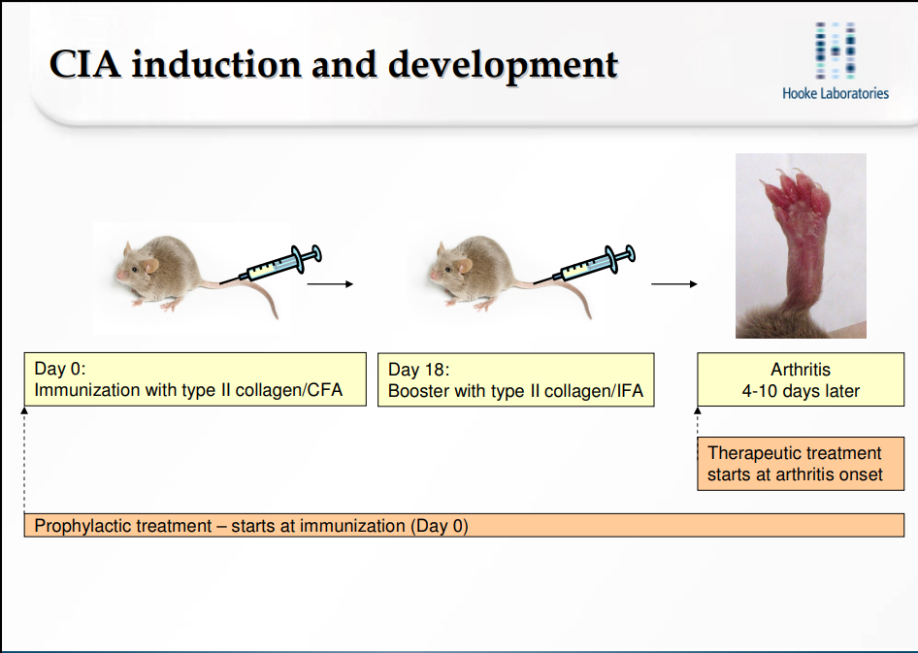
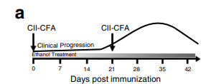
Formation CIA Model
1. CIA features
2. CFA vs IFA
3. Two immuno-injection moulding

Slide 6
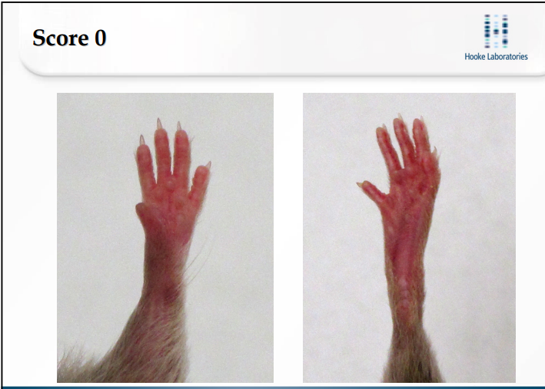
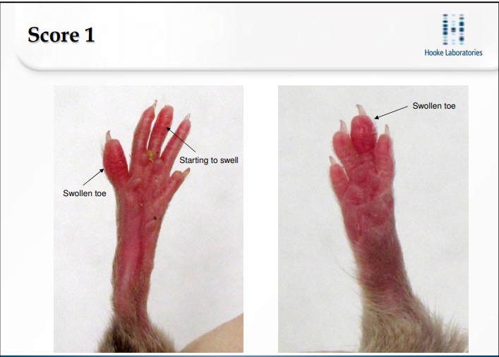
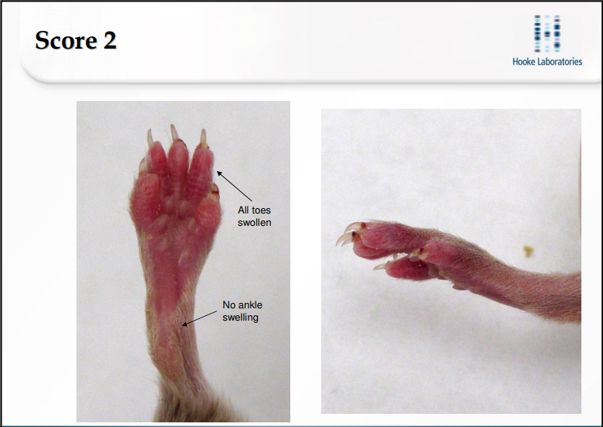
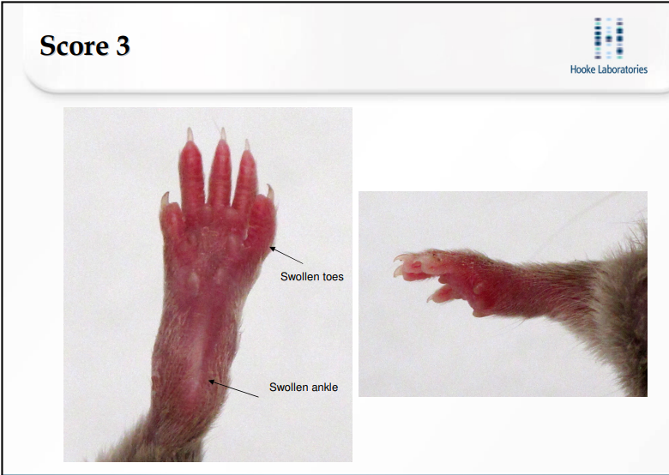
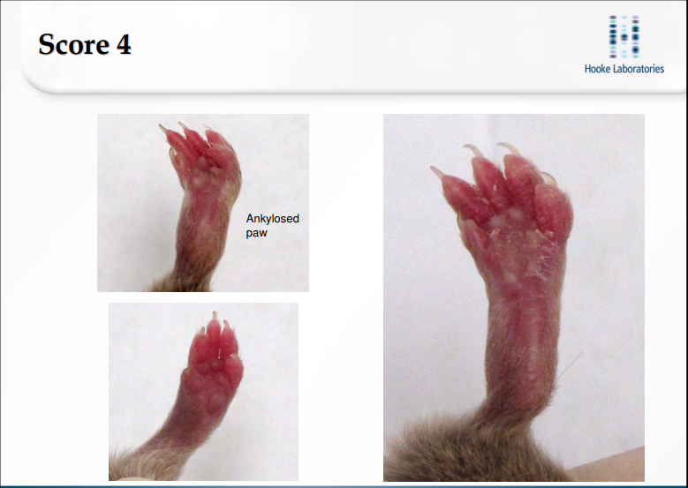
Incidence and Severity Scoring

Slide 7
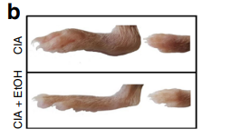
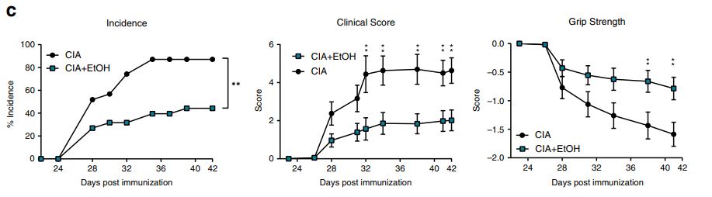
Incidence and Severity in this article

Slide 8
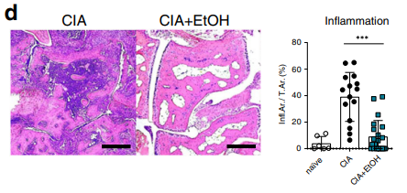
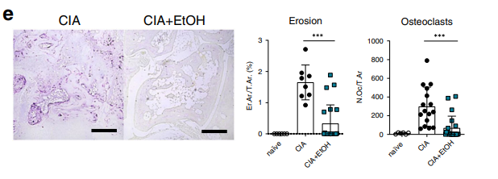
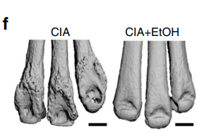
Synovial Inflammation,
Bone Erosion and Osteoclast Number
1. H&E(Hematoxylin and Eosin) stained paw sections
2. TRAP(tartrate-resistant acid phosphatase) stained paw sections
3. Micro-computed tomography.

Slide 9
Gene Expression Analysis
sample : whole paw homogenates of CIA or CIA+EtOH
method : RT-PCR (q-PCR)
result : (1) types immune response
type I cytokines IL-6, IL-1beta and IFN-gamma ↓
type II cytokines IL-4, IL-9, IL-13 and IL-33 ↑
increase type II immune can mitigate RA
(2) key cytokines of RA
IL-21 and IL-17A significantly ↓
EtOH can effectively attenuate RA in molecular level
(3) chemokines and lymphoid cells
CXCL-12, CXCR-4, Neutrophils and Monocytes ↓
CCR-3, CXCR2 and Eosinophils ↑
(4) immune cells
T cell populations and differentiation no impact

Slide 10
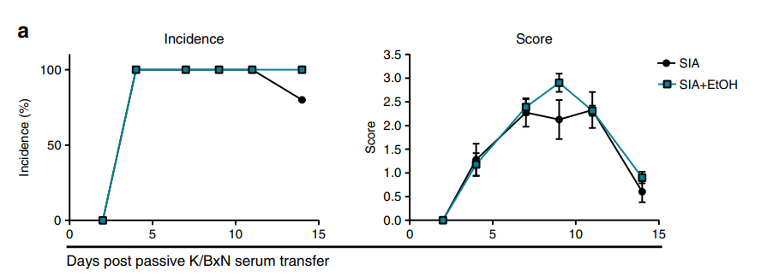
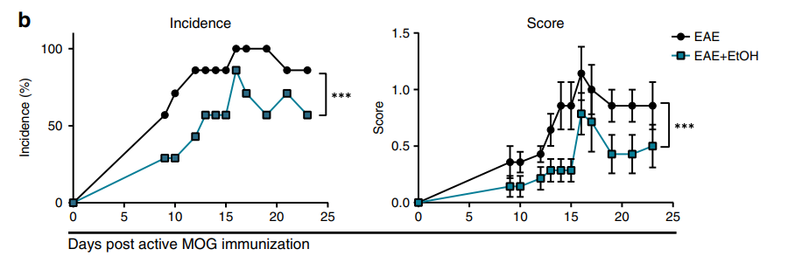
Experiments Logic
2. Confirming if EtOH inhibit RA onset via immnue response
Model : CIA turns to SIA (serum-induced arthritis) and EAE (encephalomyelitis)
SIA is not require T cell response
EAE is similar with RA, a autoimmune disease
Results : Not impact on SIA but have similar inhibiting effect on EAE
hypothese makes sense

Slide 11
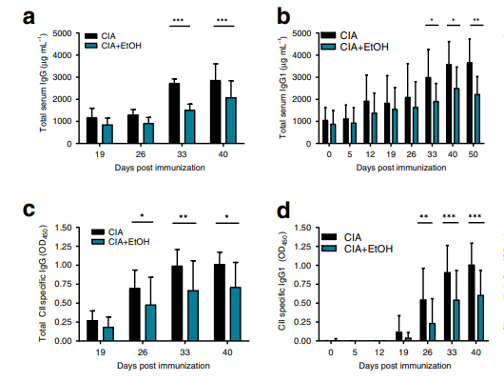
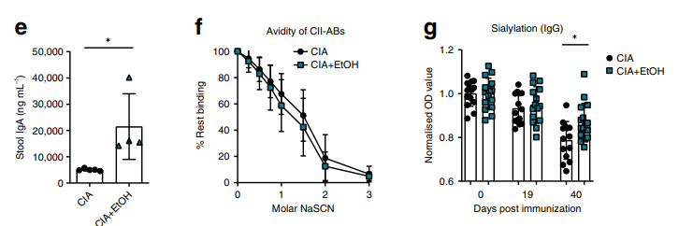
Experiments Logic
3. testing the Igs changes
sample : spleen, bone marrow and gut of CIA and CIA+EtOH
method : ELISA
results : CII-specific IgG total number ↓, but only the subclass IgG1↓
CII-specific IgG avidity no changes
CII-specific IgG sialyation significantly increases
IgA in intestinal total number ↑ but avidity no changes

Slide 12
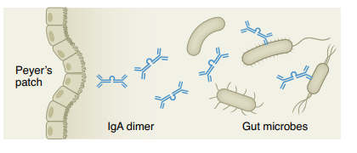
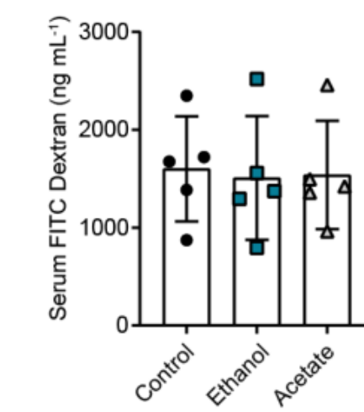
Experiments Logic
4. EtOH making IgA-change may affect the health of gut
importance of IgA :
sample ：WT and WT+EtOH
method : FITC-dextran gavage and serum FITC-dextran quantification
result : gut barrier function no change

Slide 13
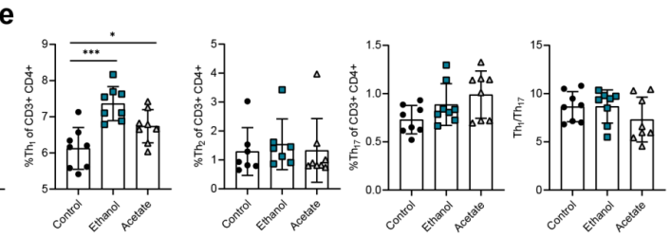
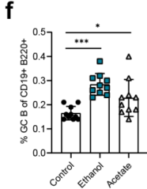
Experiments Logic
5. EtOH affects adaptive immune cells
(1) in steady state
sample : spleen of WT and WT+EtOH
method : flow cytometry analysis
result : only Th1 cell and GC B cell ↑

Slide 14
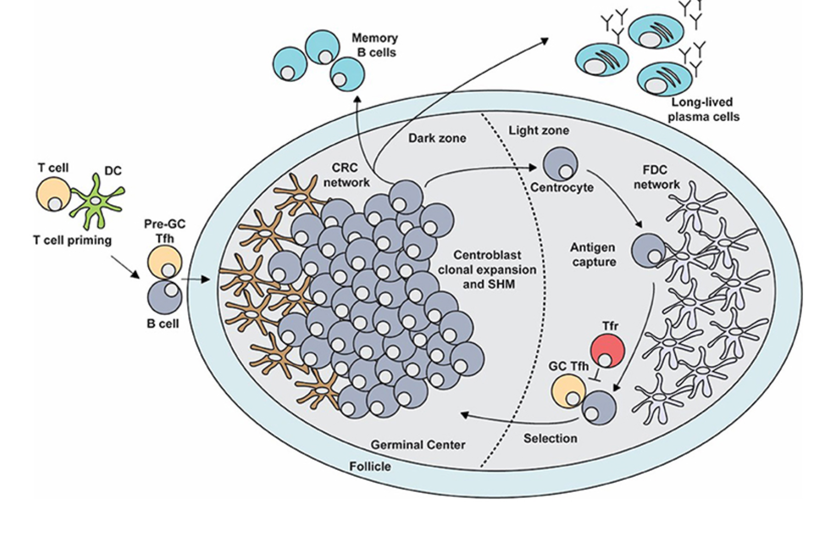
GC (germinal center) B Cell
Tfh : T follicular helper cell
FDC : follicular dendritic cell
CRC : CXCL12-producing reticular cell
Tfr : T follicular regulating cell
SHM : somatic hypermutation
class swith (抗体类别转换)
chemokine:
CXCR4 + CXCL12 vs CXCR5
GC B cell ↑ may be affected by Tfh and its products

Slide 15
Experiments Logic
5. EtOH & Acetate affects adaptive immune cells
(2). in CIA
result :
plasma B cell total number unchange but plasmablasts ↓
in spleen
plasma B cell and CII-specific IgG producing B cell ↓
follicular area and GC B cell ↓
logical explain Ig titers decreasing and the main contributor is GC B cell

Slide 16
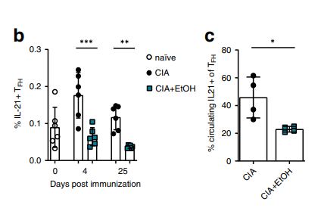
Experiments Logic
5. EtOH affects adaptive immune cells
(2). in CIA
key cytokines of Tfh : IL-21, PD-1 and Bcl6
IL-21 : antibody production and class swith
boost cytotoxicity of CD8+ T cell and NK cell
induce Th17 differentiation
PD-1 : Tfh cell activation and positioning Tfh → formation Tfh-B doublet
Bcl6 : regulate expression PD-1 of Tfh
result :
Tfh total number and IL-21⁺ Tfh ↓
IL-21 and PD-1 ↓
Tfh-B doublet ↓
ICOSL and IL-21R of GC B cell↑

Slide 17
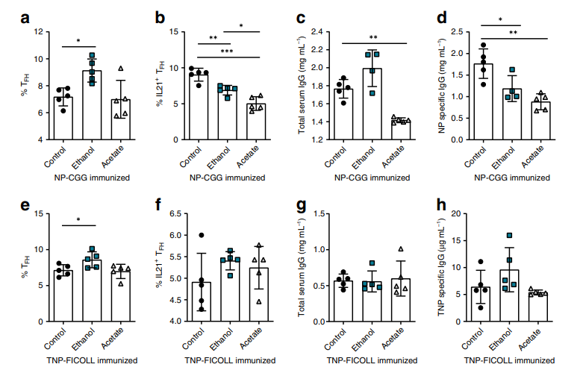
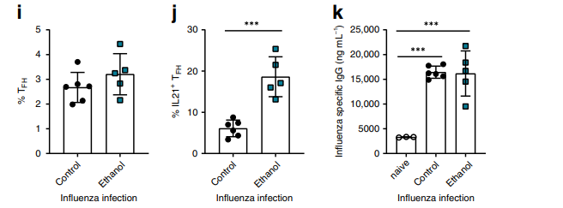
Experiments Logic
5. EtOH & Acetate affects adaptive immune cells
(3). in WT+NP-CGG, TNP-FICOLL or Influenza
NP-CGG: antigen & T dependent
TNP-FICOLL: antigen & T indepent
Influenza : virus
result :

Slide 18
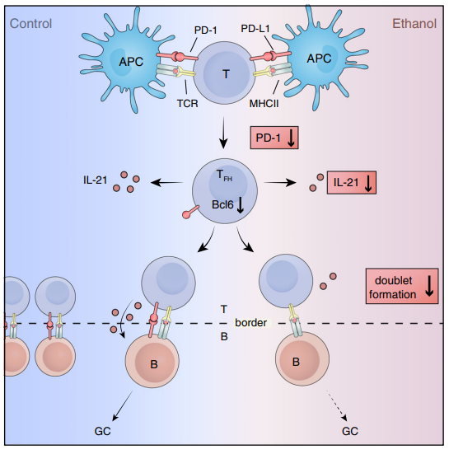
The effect of EtOH on RA Primary Mechanism

Slide 19
Discussion
the mechanism of EtOH decreasing IL-21 produced by Tfh is stil unclear
the finding primary mechanism is based on the early cellular level of RA
the interesting results do not have a logical explain

Slide 20
Reference
Azizov, V., Dietel, K., Steffen, F. et al. Ethanol consumption inhibits TFH cell responses and the development of autoimmune arthritis. Nat Commun 11, 1998 (2020). https://doi.org/10.1038/s41467-020-15855-z
Yu, D., Walker, L.S.K., Liu, Z. et al. Targeting TFH cells in human diseases and vaccination: rationale and practice. Nat Immunol 23, 1157–1168 (2022). https://doi.org/10.1038/s41590-022-01253-8
Stebegg M, Kumar SD, Silva-Cayetano A, Fonseca VR, Linterman MA and Graca L (2018) Regulation of the Germinal Center Response. Front. Immunol. 9:2469. doi: 10.3389/fimmu.2018.02469

